Slide 1
MERN

Slide 2
MERNG

Slide 3
MERNG
ongoDB
xpressJS
eactJS
odeJS
raphQL

Slide 4
MERNG
ongoDB
MongoDB is a source-available cross-platform document-oriented database program. Classified as a NoSQL database program, MongoDB uses JSON-like documents with optional schemas.
xpressJS
eactJS
odeJS
raphQL

Slide 5
MERNG
ongoDB
Express.js, is a back-end web application framework for Node.js,. It is designed for building web applications and APIs. It has been called the de facto standard server framework for Node.js.
xpressJS
eactJS
odeJS
raphQL

Slide 6
MERNG
ongoDB
React is a free and open-source front-end JavaScript library for building user interfaces based on UI components. React can be used as a base in the development of single-page or mobile applications.
xpressJS
eactJS
odeJS
raphQL

Slide 7
MERNG
ongoDB
xpressJS
Node.js is an open-source, cross-platform, back-end JavaScript runtime environment that runs on the V8 engine and executes JavaScript code outside a web browser
eactJS
odeJS
raphQL

Slide 8
MERNG
ongoDB
xpressJS
GraphQL is an open-source data query and manipulation language for APIs, and a runtime for fulfilling queries with existing data. GraphQL was developed internally by Facebook in 2012 before being publicly released in 2015.
eactJS
odeJS
raphQL

Slide 9
TypeScript

Slide 10
What is TypeScript ?

Slide 11
A programing language to address shortcomings of JavaScript

Slide 12


Slide 13
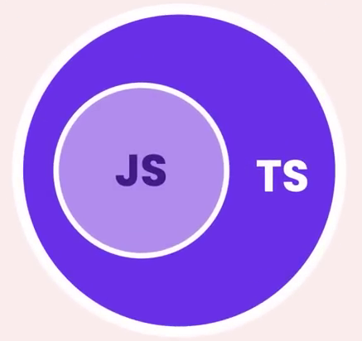

Slide 14

Benefits
Static Typing
Code Completion
Refactoring
Shorthand Notations

Slide 15

Type Checking
Code Completion
Refactoring
New Features

Slide 16
Next.js 15

Slide 17
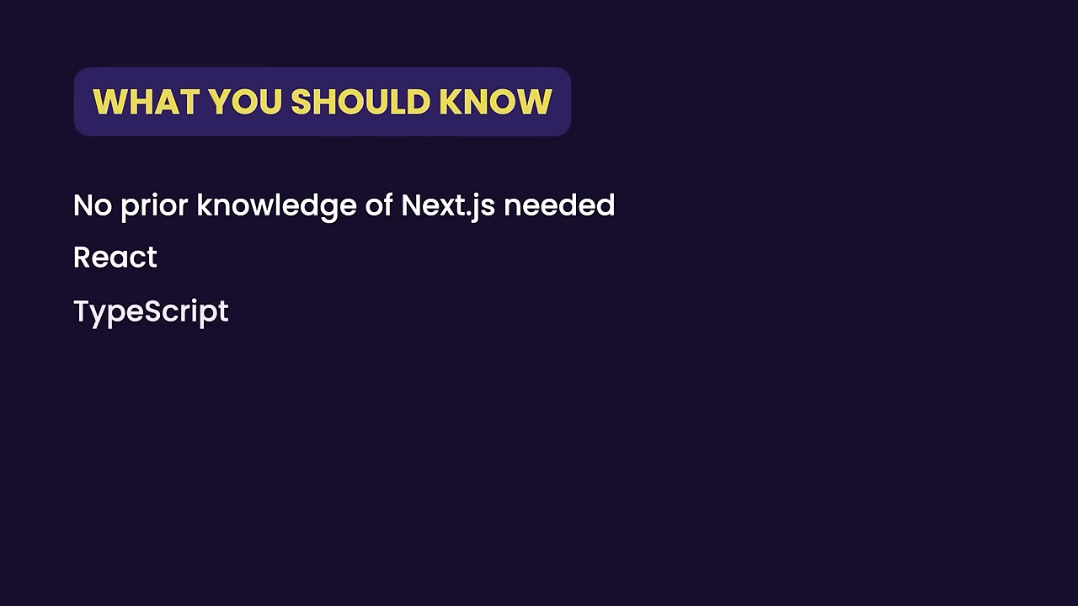

Slide 18
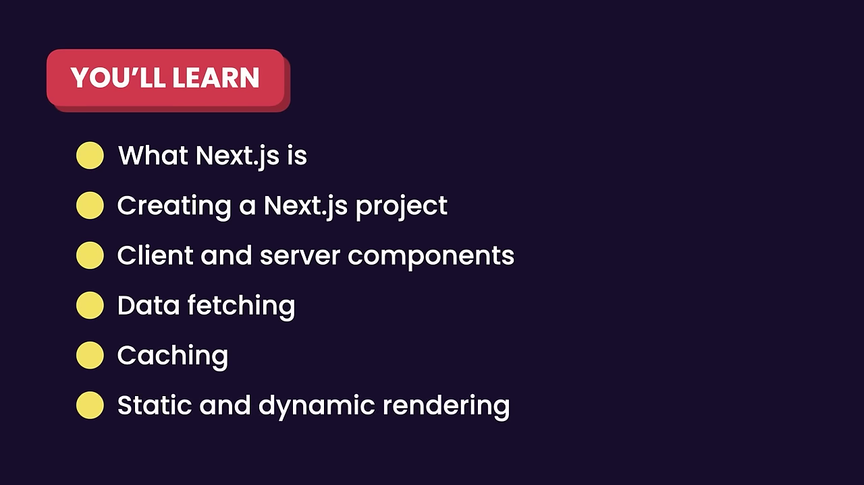

Slide 19
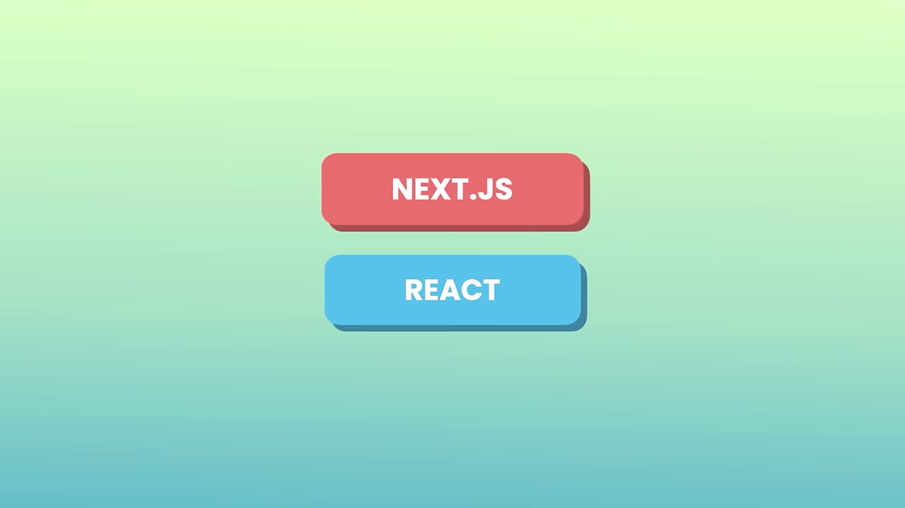

Slide 20
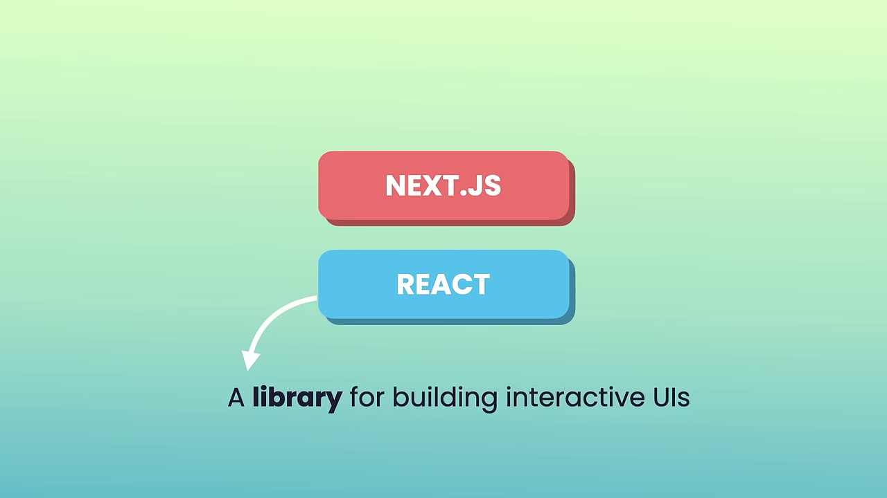

Slide 21
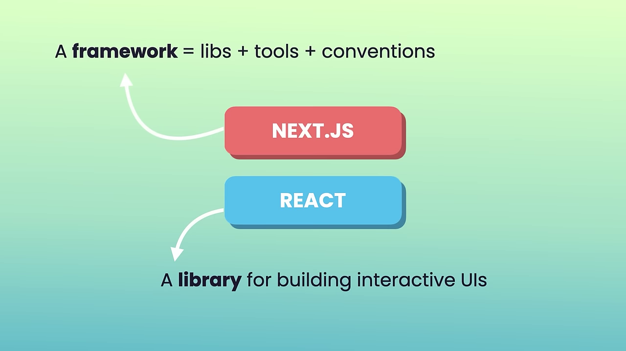

Slide 22
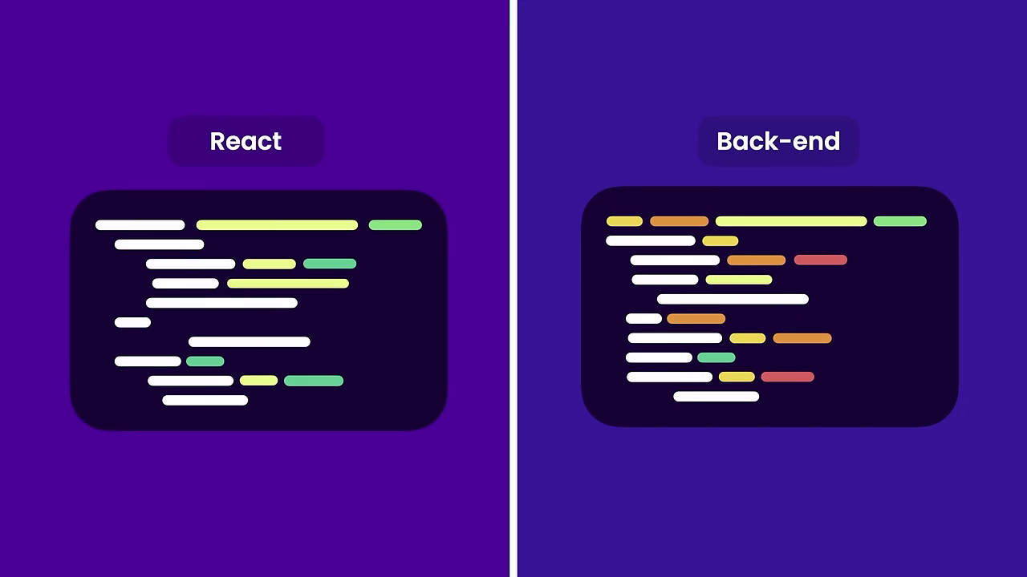

Slide 23
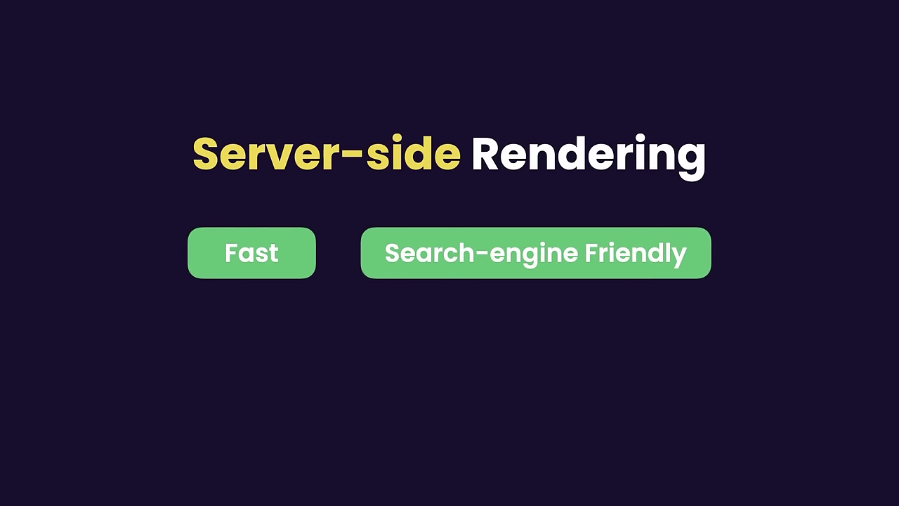

Slide 24
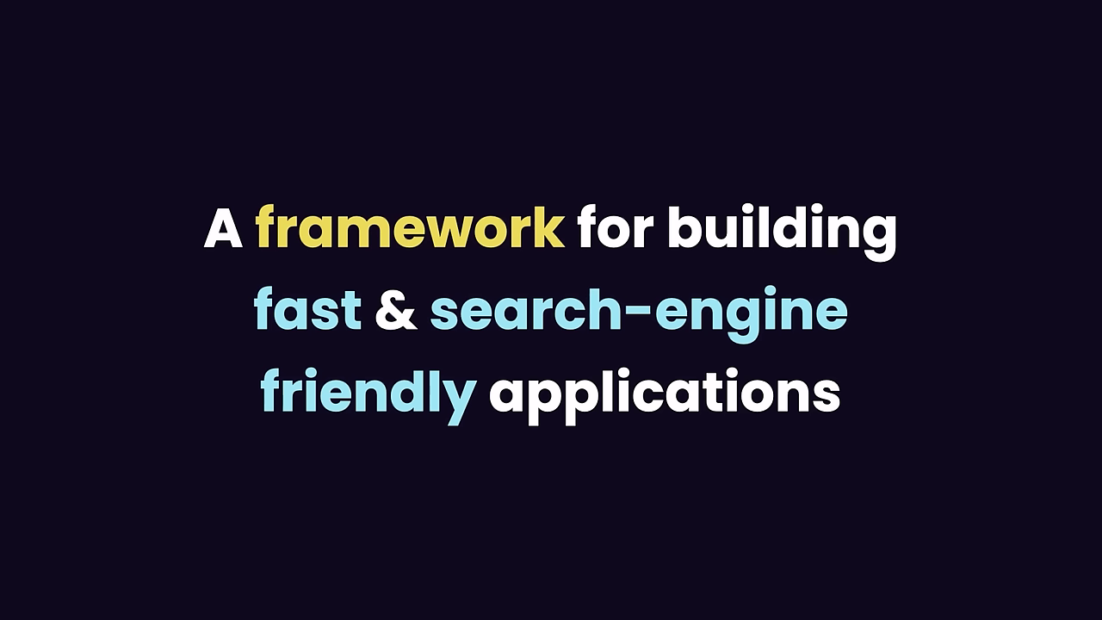

Slide 25


Slide 26
A runtime environment for executing JavaScript code

Slide 27
We often use Node to build back-end services

Slide 28
API

Slide 29
Application Programming Interface

Slide 30
Web App
Back-end Service
Mobile App

Slide 31
Highly-scalable, data-intensive and real-time apps

Slide 32
Great for prototyping and agile development
Superfast and highly scalable

Slide 33


Slide 34
Build twice as fast with fewer people
33% fewer line of code
NODE APP
40% fewer files
2x request/sec
35% faster response time

Slide 35
Great for prototyping and agile development
Superfast and highly scalable
JavaScript everywhere
Clear and more consistent codebase
Large ecosystem of open-source libs

Slide 36
A runtime environment for executing JavaScript code

Slide 37
Browser

Slide 38
Browser
JS
CODE
JS ENGINE
MACHINE
CODE

Slide 39



SpiderMonkey
V8
Chromium / V8

Slide 40
Browser
Runtime Environment
JavaScript Engine

Slide 41
document.getElementById(‘ ’);

Slide 42
JS in browsers
2009

Slide 43
Ryan Dahl

Slide 44
Chrome
V8

Slide 45
Chrome
V8
V8

Slide 46
Chrome
Node.exe
V8
V8

Slide 47
document.getElementById(‘ ’);

Slide 48
document.getElementById(‘ ’);

Slide 49
document.getElementById(‘ ’);
fs.readFile()
http.createServer()

Slide 50
Chrome
Node.exe
V8
V8

Slide 51

I prefer Node to C#

Slide 52
Node is NOT a programming language!

Slide 53

I prefer Node to ASP.NET

Slide 54
Node is NOT a framework!

Slide 55
A runtime environment for executing JavaScript code

Slide 56
Highly-scalable, data-intensive and real-time apps

Slide 57
How NodeJS works ??

Slide 58
Non-blocking
ASYNCHRONOUS

Slide 59
Blocking
SYNCHRONOUS

Slide 60


Request
Response
Client
Server

Slide 61



Request
Response
Client
Server
GET /
<html> ...

Slide 62


Request
Response

Slide 63
Request
Response
Request
Response
Request
Response
Request
Response

Slide 64
Server

Slide 65
Server
Server

Slide 66


Synchronous / blocking
Tyre Shop

Slide 67
Synchronous / blocking
Tyre Shop

Slide 68
Synchronous / blocking
Tyre Shop

Slide 69
Asynchronous / Non-blocking
Tyre Shop

Slide 70
Asynchronous / Non-blocking
Tyre Shop

Slide 71
Asynchronous / Non-blocking
Tyre Shop

Slide 72
Asynchronous / Non-blocking
Tyre Shop

Slide 73
Asynchronous / Non-blocking
Tyre Shop

Slide 74
Asynchronous / Non-blocking
Node JS
Event Loop
Request
Request
Feedback

Slide 75
Node applications are asynchronous by default

Slide 76
Node is ideal for I/O-intensive like real-time & data intensive apps

Slide 77
Do not use Node for is ideal for CPU-intensive apps

